Slide 1
Prepare for the 2019 PSAT™ 10

Slide 2
Contents
What Is the PSATTM 10?
When Is the 2019 PSAT 10?
Skills Tested on the PSAT 10
How to Prepare for the PSAT 10
Sample PSAT 10 Questions
Resources

Slide 3
What Is the PSAT 10?

Slide 4
Some Key Facts
Scores for the SAT® Suite of Assessments (SAT, PSAT/NMSQT®, PSAT 10, and PSATTM 8/9) are reported on a common vertical scale, allowing educators to measure students progress.
The PSAT 10 propels students toward college and career readiness.
The PSAT/NMSQT and PSAT 10 are the same test, offered at different times of the year.
The PSAT/NMSQT and PSAT 10 test the same skills and knowledge as the SAT—in a way that makes sense for your grade level.
The PSAT 10 serves as an entry point to over $235 million in scholarships for qualified students with financial need.

Slide 5
What to Know About the PSAT 10
Test length: 2 hours 45 minutes
No penalty for guessing or blank responses, also known as “rights-only scoring”
Scale ranges for the scores are 320–1520 for the total score

Slide 6
Benefits of the PSAT 10
Aligned to the SAT
Increased access to scholarship providers
Online college and career planning tools on BigFuture™
Student score reports recommend Advanced Placement® courses that may be good matches
Majors and career exploration with the College Board and Roadtrip Nation
Free, personalized official SAT practice on Khan Academy based on PSAT 10 scores

Slide 7
PSAT 10 Test Dates
The PSAT 10 is given in two testing periods:
FEB. 25 – MARCH 29, 2019
APRIL 1 – APRIL 26, 2019

Slide 8
Skills Tested on the PSAT 10

Slide 9
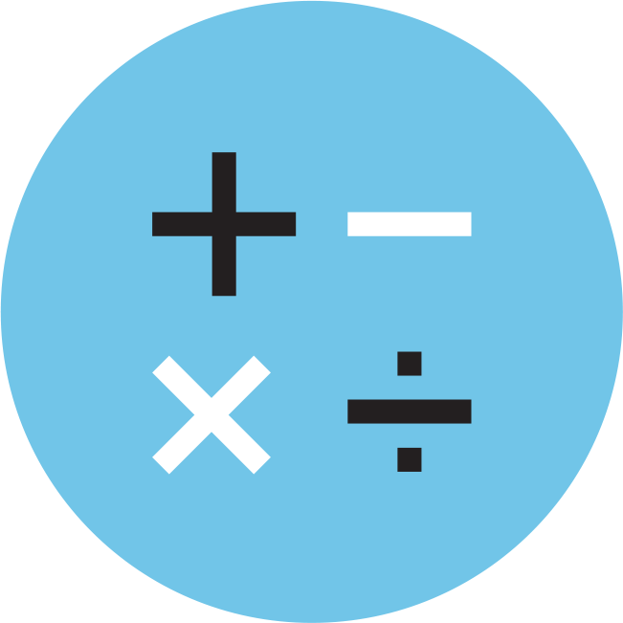
Skills Tested
Reading Test
Writing and Language Test
Math Test
Each test assesses the academic skills that students have developed over the years, primarily through their coursework.
These skills are considered essential for success in high school, college, and career.

Slide 10
Reading Test
5 Passages
47 Passage-Based Questions; 60 minutes
Quick Facts
All questions are multiple choice and based on passages.
Some passages are paired with other passages or informational graphics such as tables and graphs.
No mathematical computation is required.
Prior topic-specific knowledge is never tested.

Slide 11
Reading Test
What to Expect
In the Reading Test, students will encounter questions like those asked in a lively, thoughtful, evidence-based discussion.

Slide 12
Writing and Language Test
4 Passages
44 Passage-Based Questions; 35 minutes
Quick Facts
All questions are multiple choice and based on passages.
Some passages are paired with informational graphics such as tables and graphs.
No mathematical computation is required.
Prior topic-specific knowledge is never tested.

Slide 13
Writing and Language Test
What to Expect
The Writing and Language Test puts students in the active role of an editor who is improving a written passage. Most questions ask students to decide which, if any, of the three alternatives to an underlined part of a passage most improves it.

Slide 14
Math Test
2 Test Sections; 70 minutes
48 Questions (40 multiple choice, 8 grid-ins)
Quick Facts
Most math questions will be multiple choice, but some will be student-produced responses (grid-ins).
The Math Test is divided into two portions: Math Test – Calculator and Math Test – No Calculator.
Some parts of the test will present students with a scenario and then ask several questions about it.

Slide 15
Math Test
What to Expect
The Math Test focuses on the math that matters most for college and career readiness. To succeed on the Math Test, students will need to demonstrate mathematical practices, such as problem solving and using appropriate tools strategically.

Slide 16
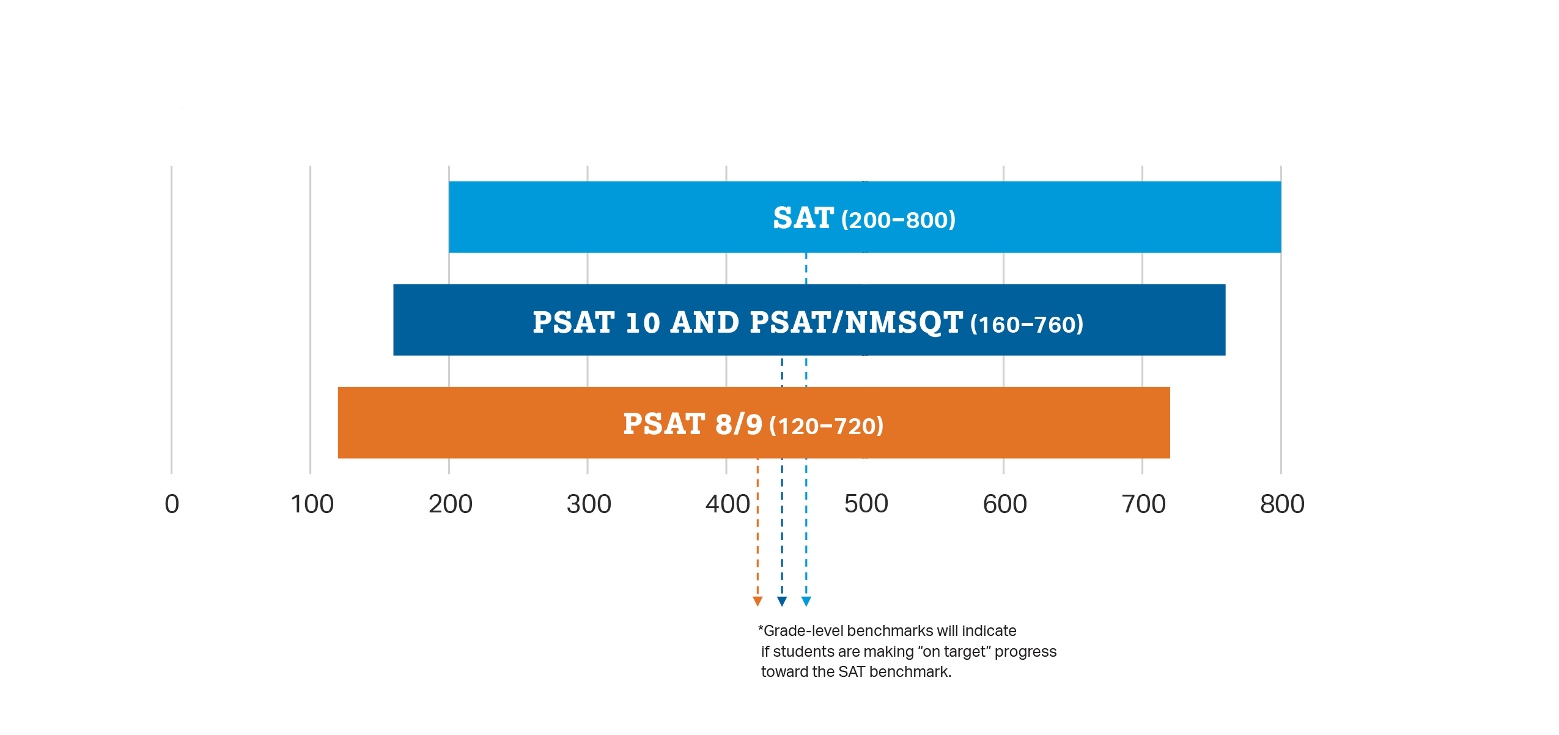
How Do the PSAT/NMSQT and PSAT 10 Connect to the SAT?
Content and Domain Alignment
All tests in the SAT Suite of Assessments (SAT, PSAT/NMSQT, PSAT 10, and PSAT 8/9) are aligned to the same research backbone and focus on the same domain of knowledge and skills.
Scoring
All tests in the SAT Suite of Assessments are on a common score scale that provides consistent feedback, enabling teachers to adjust instruction to better support students who are ahead or behind.

Slide 17
How Do the PSAT/NMSQT and PSAT 10 Connect to the SAT?
That means the score students get on the PSAT/NMSQT or PSAT 10 is the same score they would have gotten on the SAT if they’d taken it on the same day.

Slide 18
How Do the PSAT/NMSQT and PSAT 10 Compare to the SAT?
PSAT/NMSQT
and PSAT 10
2 hours 45 minutes
X
160–760
SAT
3 hours 50 minutes
Optional
200–800
Time
Essay
Section Score Range

Slide 19
How to Prepare for the PSAT 10

Slide 20
Know How the PSAT 10 Is Scored
Rights-Only Scoring
1 point for each correct answer
0 points deducted for each incorrect or blank question
Math Grid-ins
You can enter answers as (reduced) fractions or decimals.
If rounding a decimal, make sure to use every box.
Scale
160–760 for each test section
320–1520 for the total score

Slide 21
Personalized Skills Information
The PSAT 10 Score Report
Contains information to help students improve academic skills.
Lists skills that students have the best chance of improving with additional work.
Connects to personalized practice recommendations on Khan Academy.

Slide 22
Preparation Starts in School
Read
Continuous reading improves vocabulary and develops essential skills.
Take Challenging Courses
This will help students to develop and strengthen their critical thinking skills.

Slide 23
Sample PSAT 10 Questions

Slide 24
Reading Test
Passage-Based Questions

Slide 25
Reading Test
Passage-Based Questions

Slide 26
Reading Test
Passage-Based Questions

Slide 27
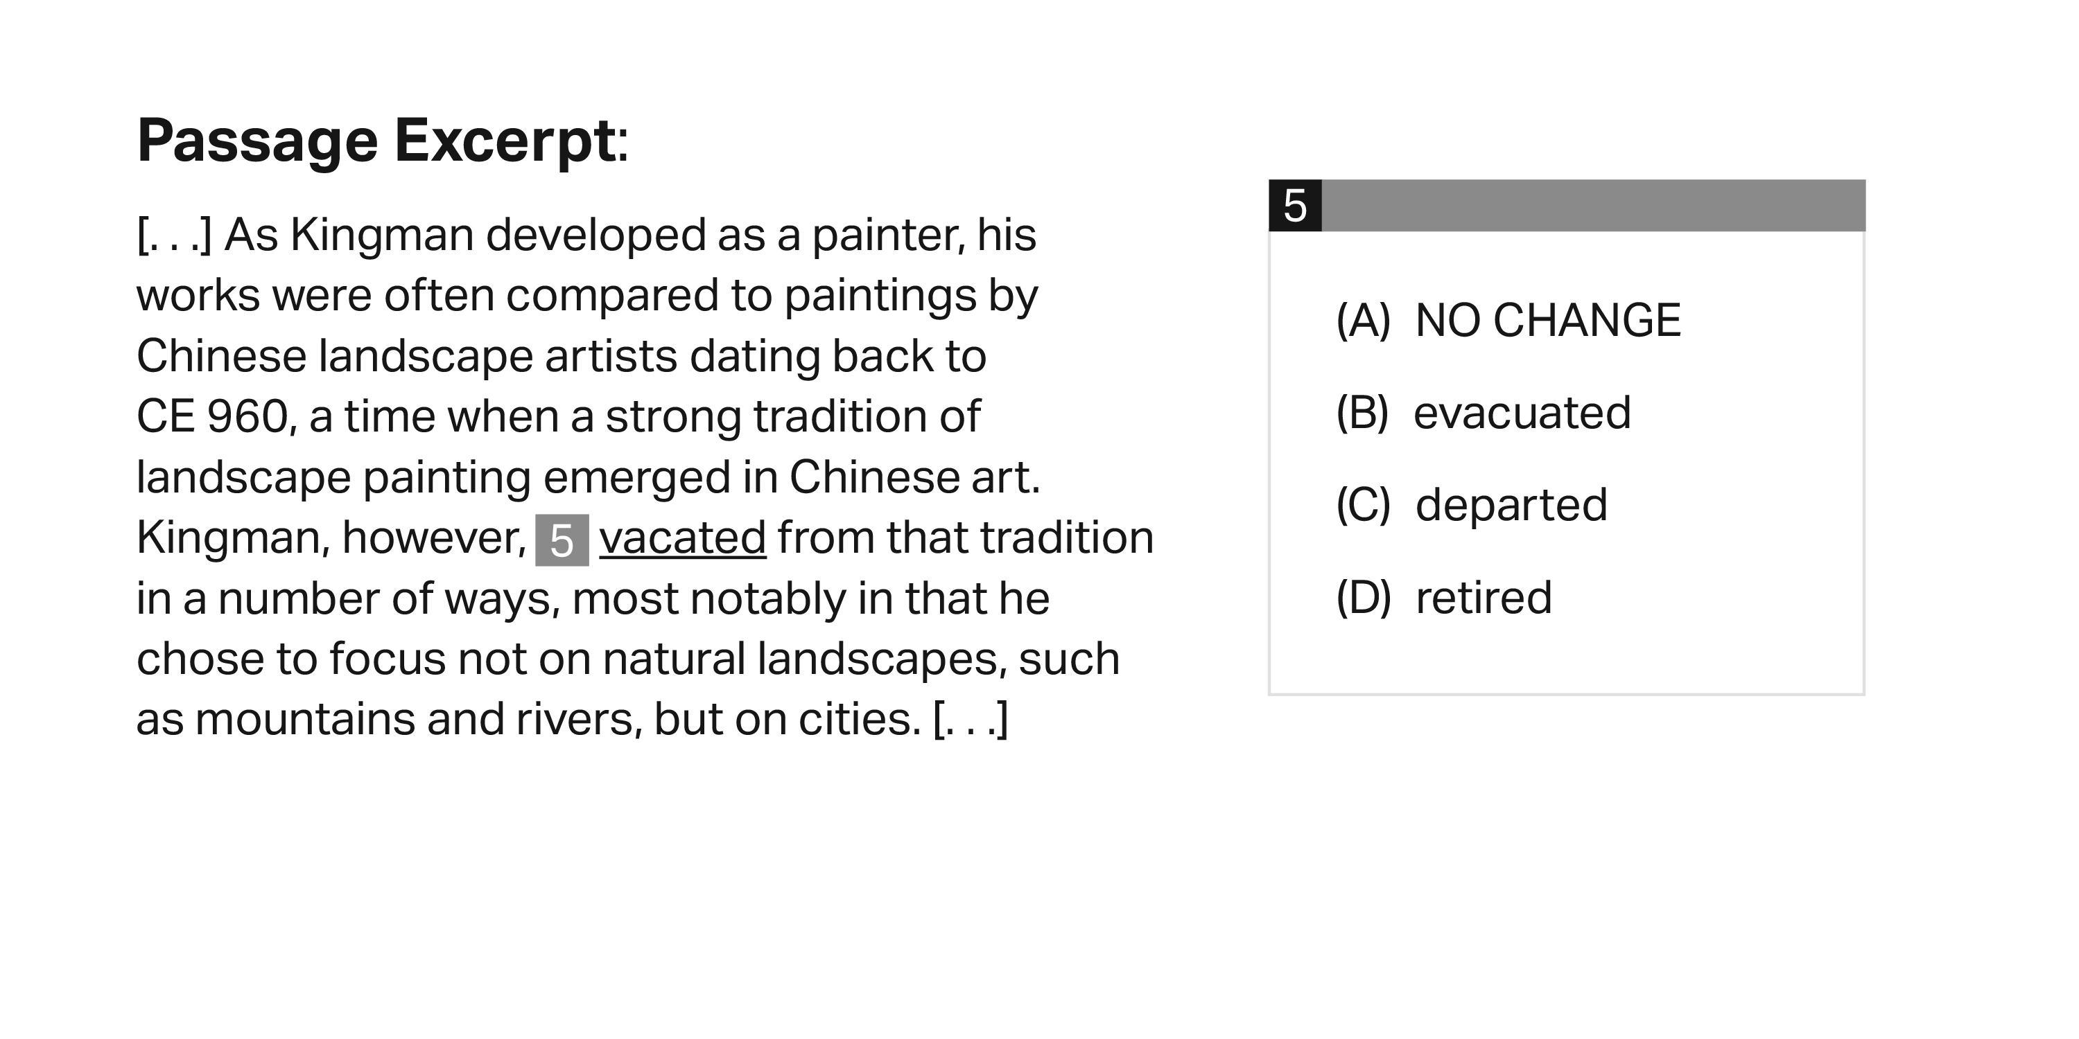
Writing and Language Test
Passage-Based Questions

Slide 28
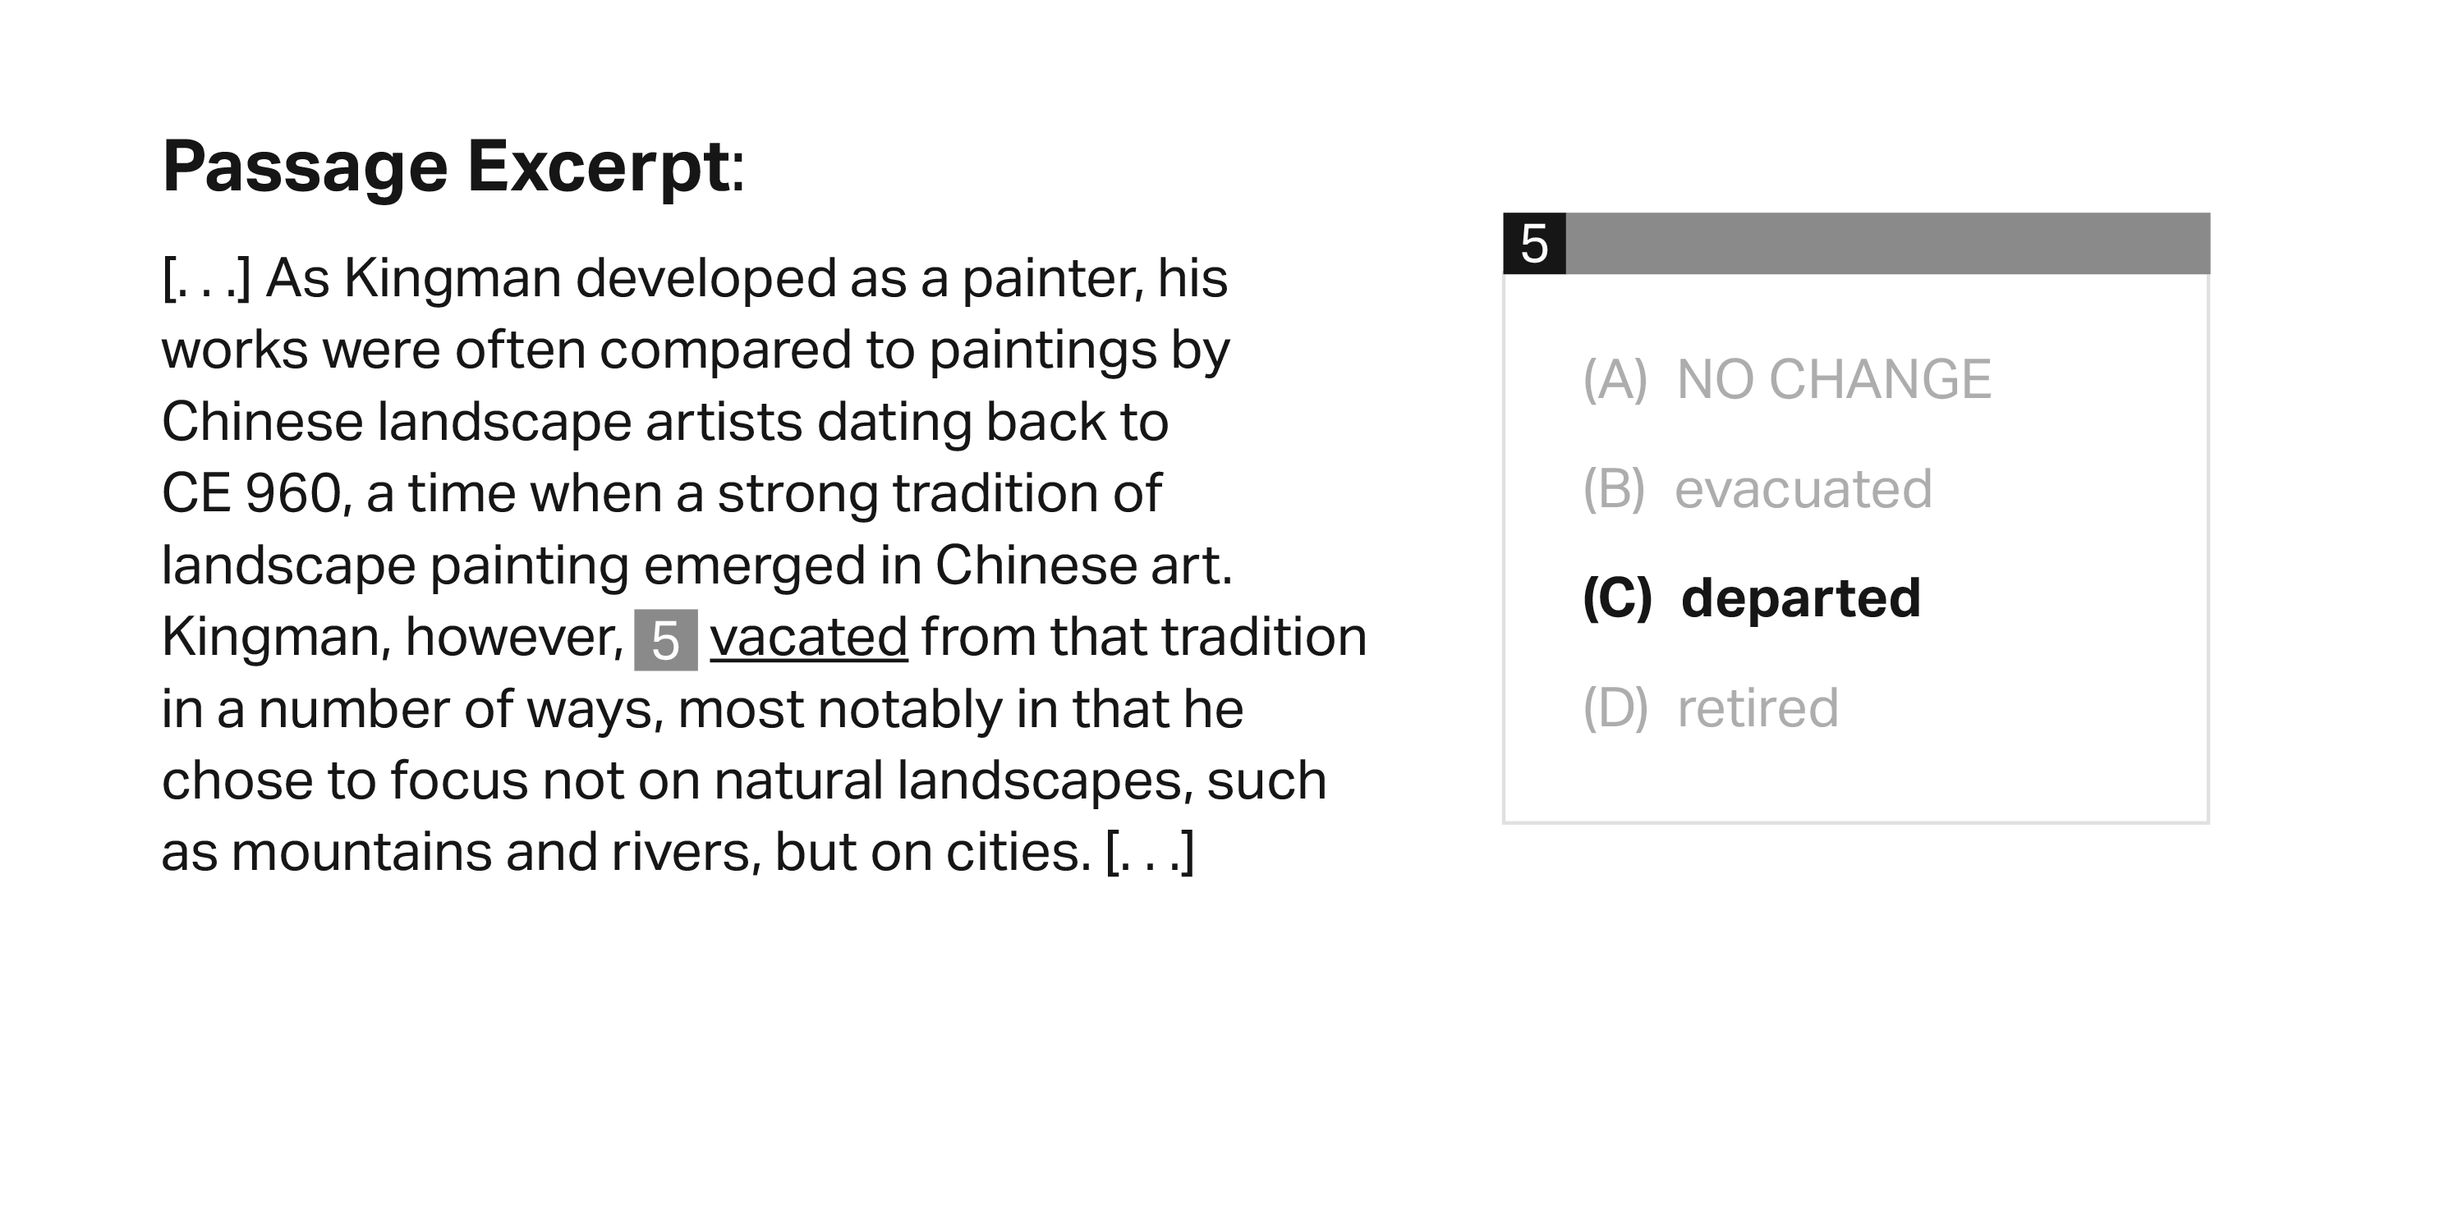
Writing and Language Test
Passage-Based Questions

Slide 29
Writing and Language Test
Passage-Based Questions

Slide 30
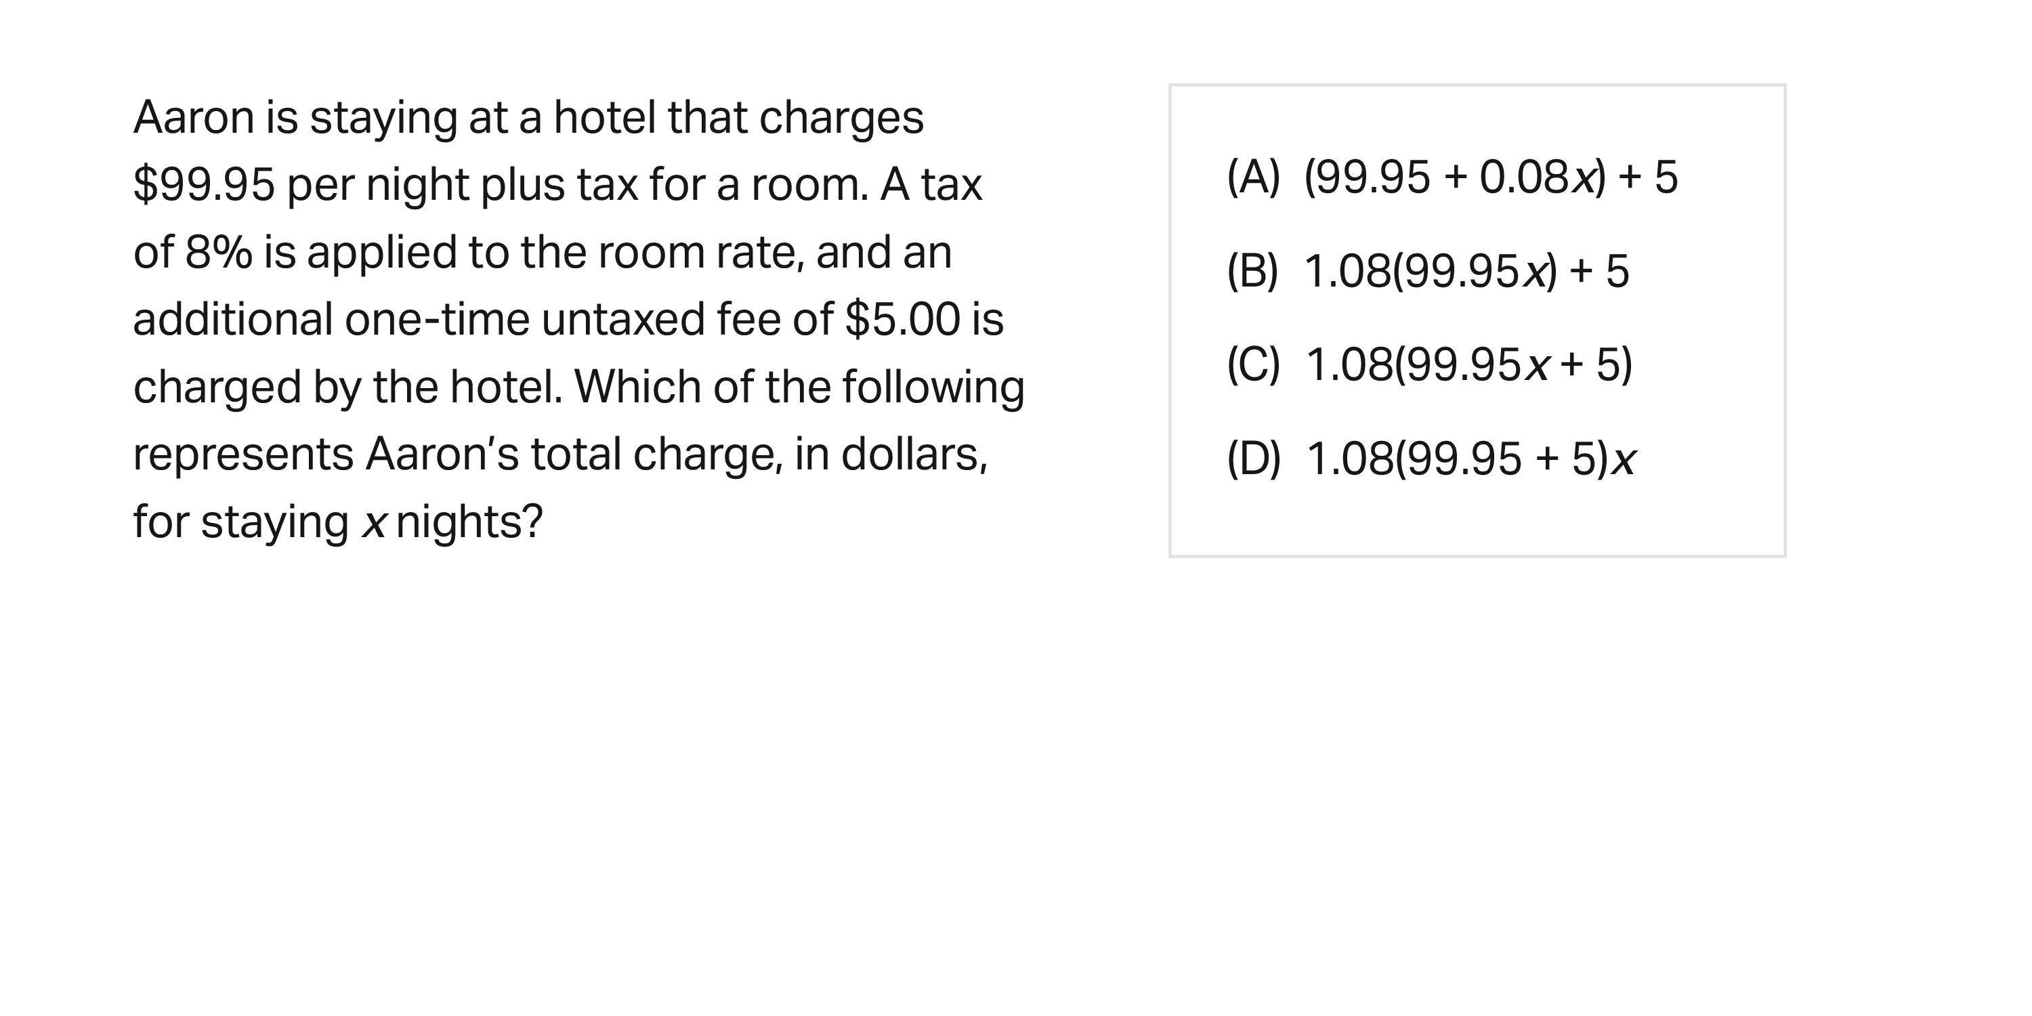
Math Test
Calculator: Permitted

Slide 31
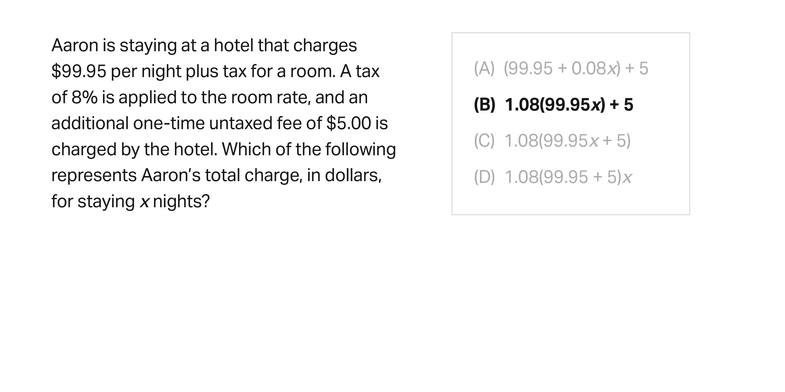
Math Test
Calculator: Permitted

Slide 32
Math Test
Calculator: Permitted

Slide 33
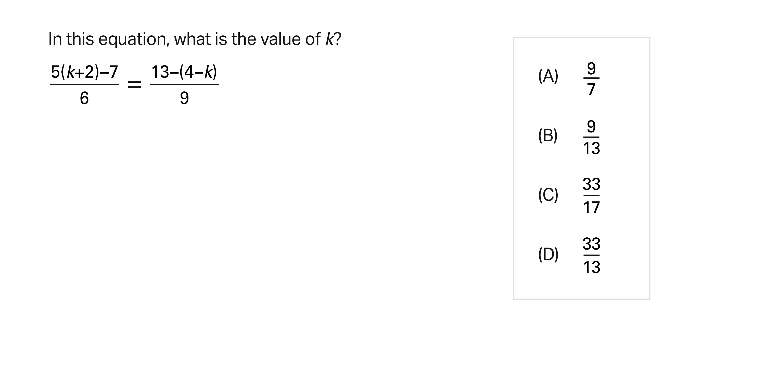
Math Test
Calculator: Not Permitted

Slide 34
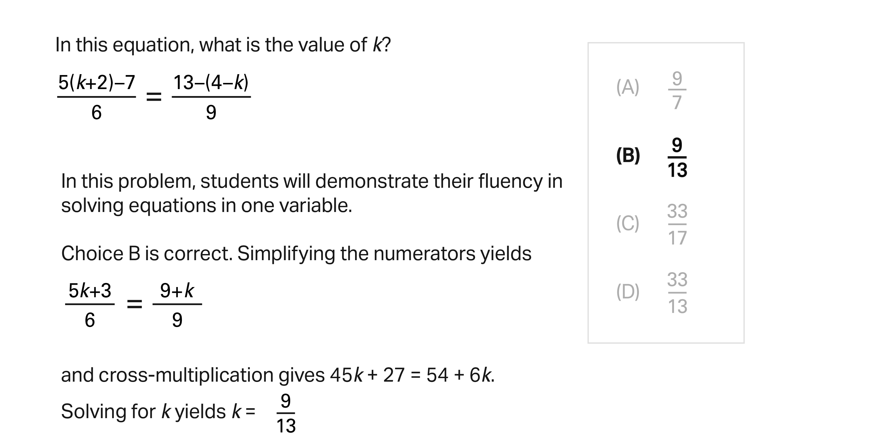
Math Test
Calculator: Not Permitted

Slide 35
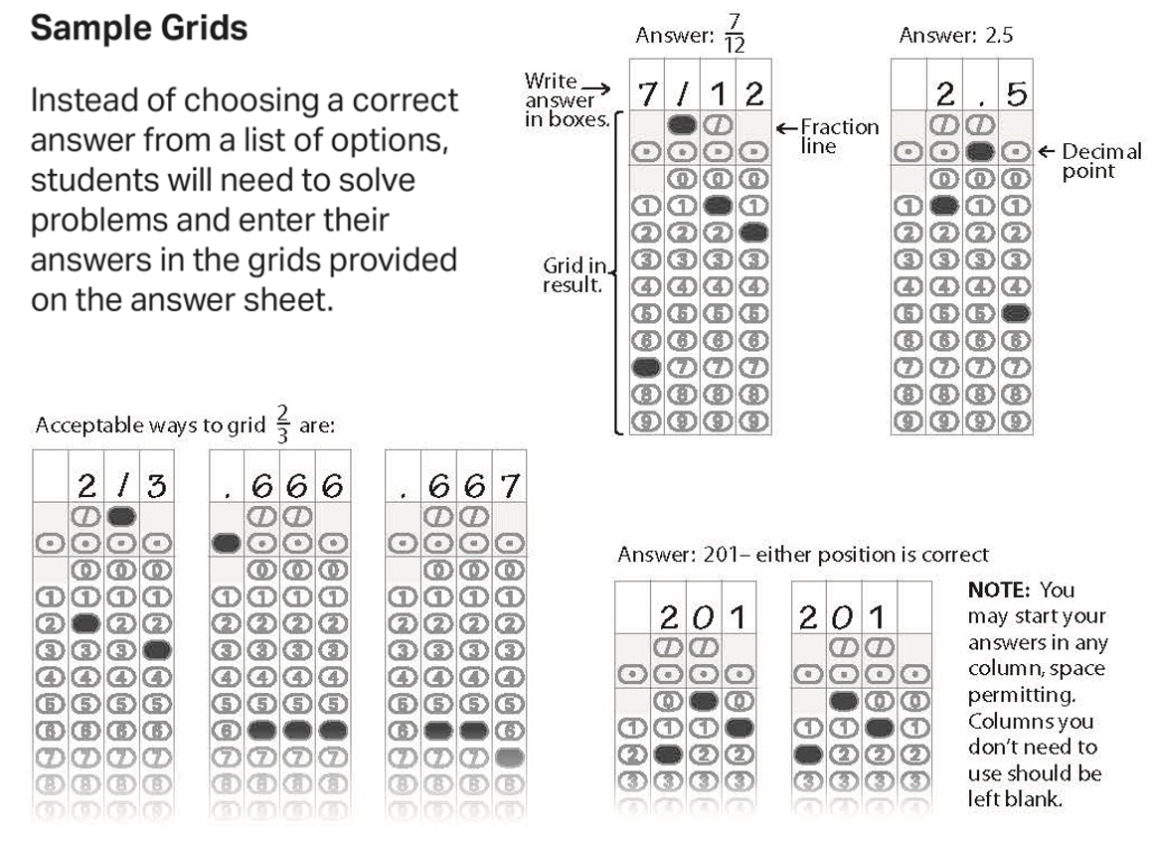
Math Section
Student-Produced Responses

Slide 36
Math Section
Students: Know Your Calculator
A scientific or graphing calculator is recommended.
Students should bring a familiar calculator. Test day is not the time to figure out how to use a new calculator.
Math Test – Calculator

Slide 37
Math Section
Additional Calculator Tips for Students
Don’t try to use the calculator on every question―no question requires one.
Decide how to solve each problem; then decide whether to use a calculator.
Make sure your calculator is in good working order and that batteries are fresh.
Students will not be permitted to use laptops or other computers, tablets, cell phones, or smartphones, etc. Please reference the PSAT 10 Student Guide for a complete list.
Math Test – Calculator

Slide 38
Resources

Slide 39
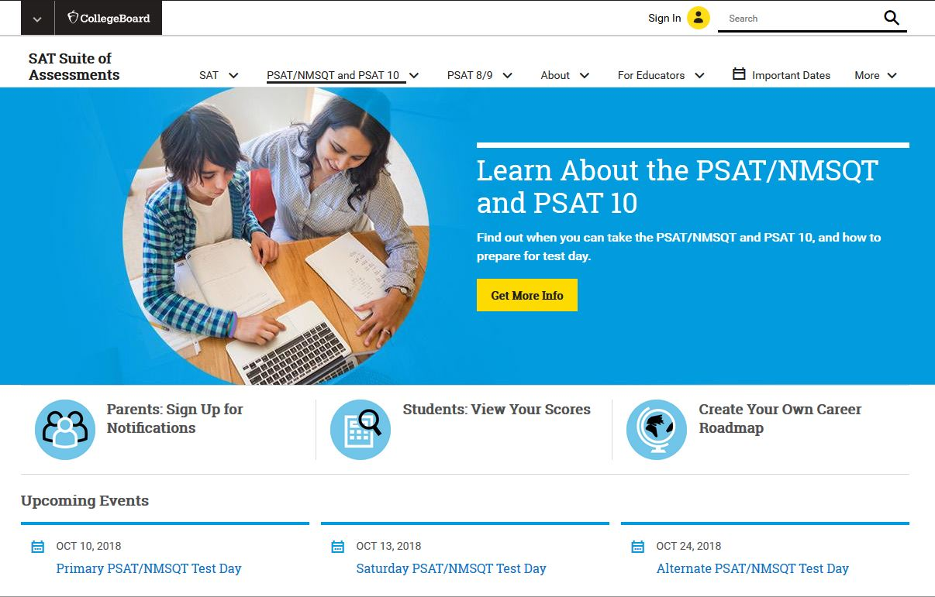
Resources
For general information about the PSAT/NMSQT and PSAT 10, please visit:
collegeboard.org/psat

Slide 40
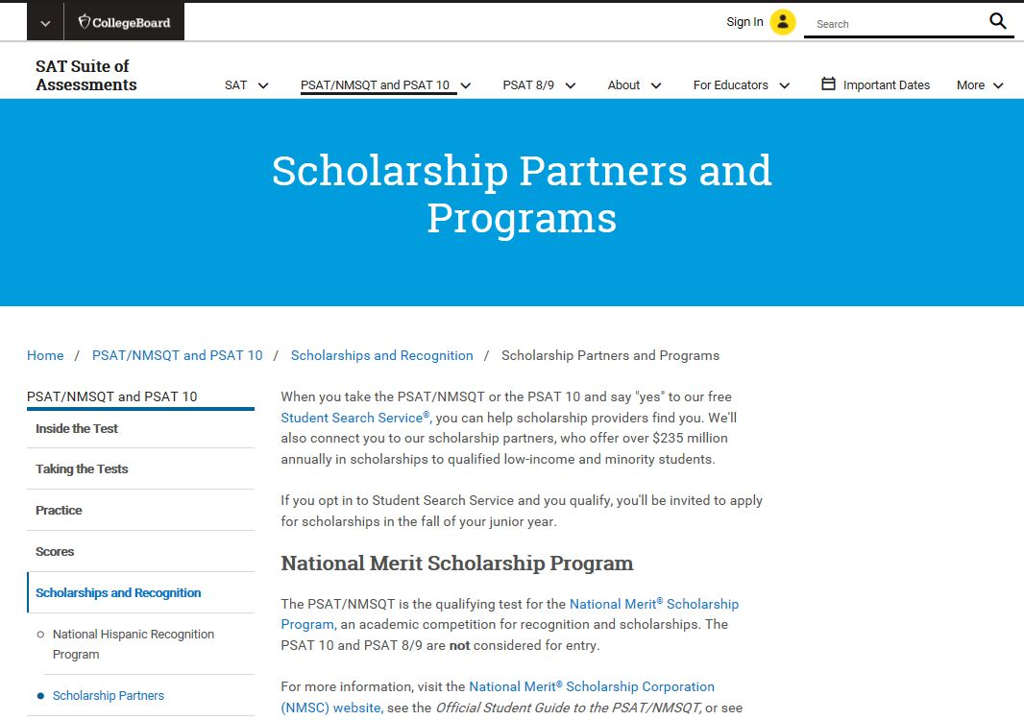
Resources
To find out more about scholarship opportunities, visit:
psat.org/scholarships

Slide 41
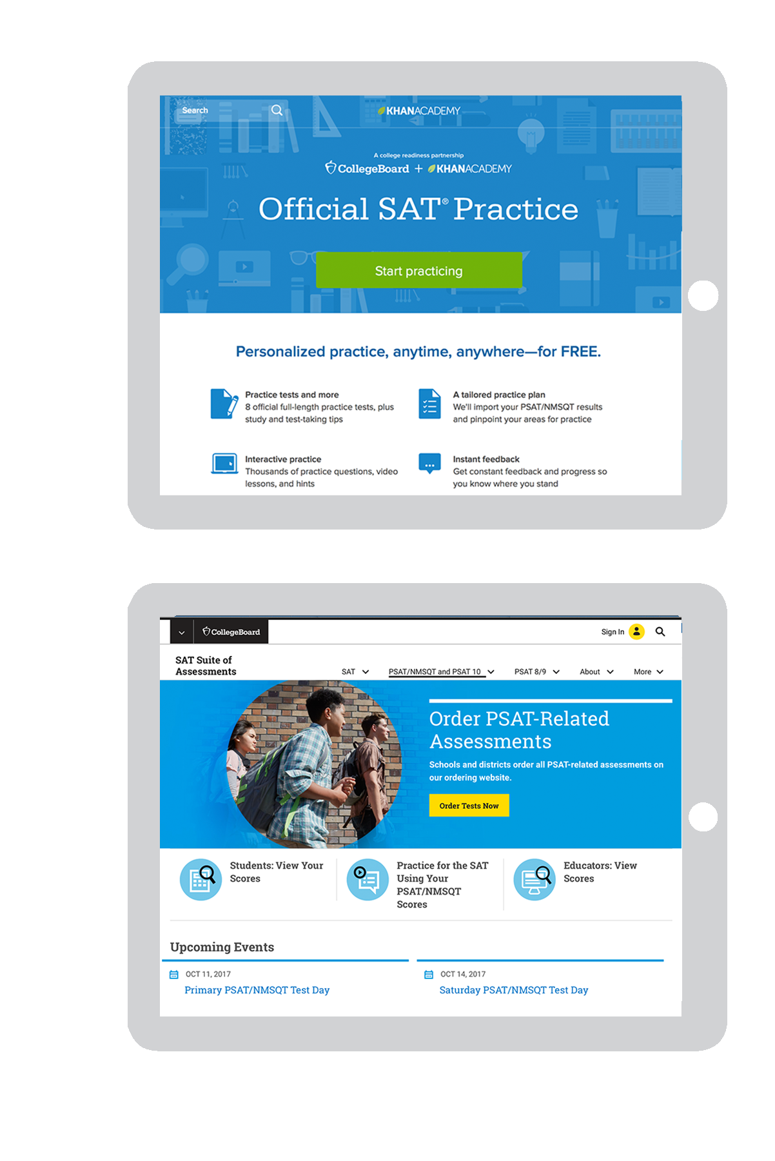
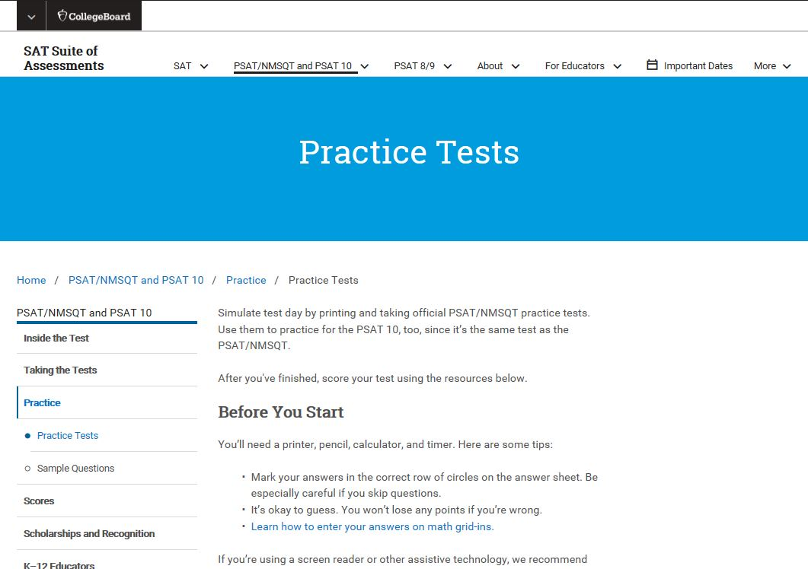
Resources
For free, personalized official SAT practice based on PSAT 10 scores, visit:
khanacademy.org/sat
Take a PSAT 10 practice test in the PSAT 10 Student Guide, available through your counselor or at:
collegeboard.org/psatpractice

Slide 42
Take the 2019 PSAT 10
How to Sign Up:
Test Day/Date:
Time:
Location:
____________________
____________________
____________________
____________________
Make sure you bring:
Two No. 2 pencils
Calculator (optional)

Slide 43
Good luck!

